Slide 1
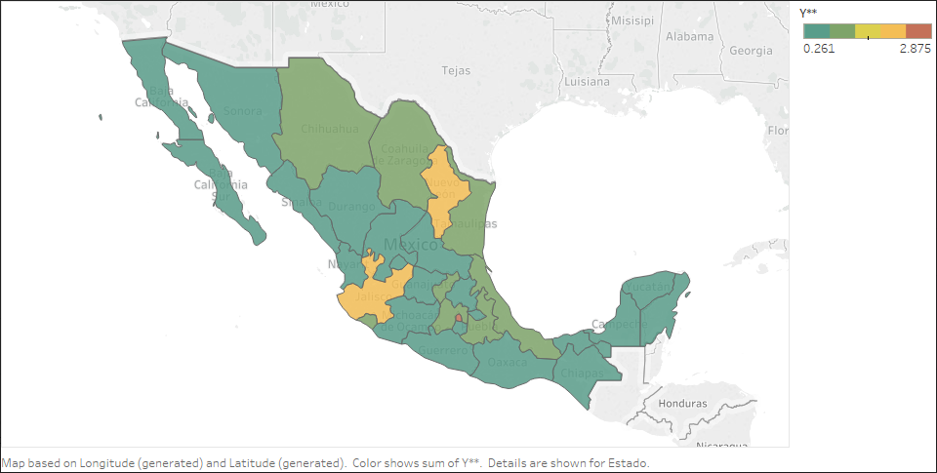
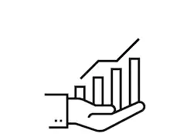
Projected E-commerce
Boom in Mexico
Tezca Hernández
Raúl Domínguez
Alejandra Guizar
Edward González

Slide 2
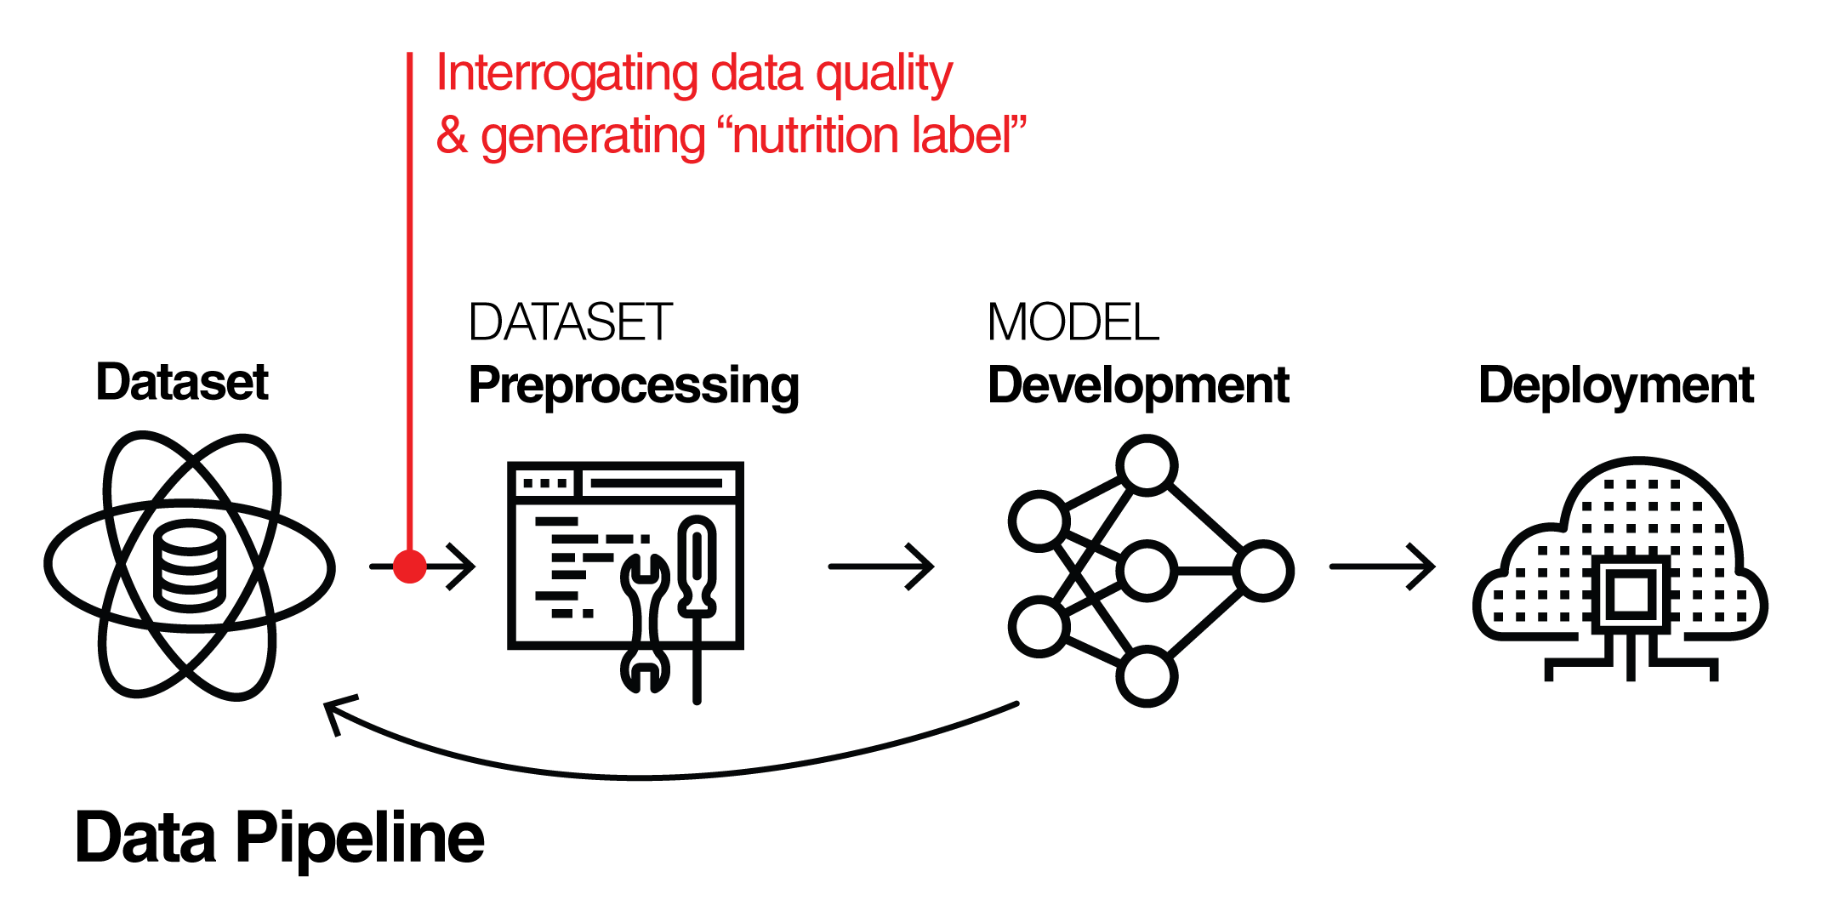

Project Timeline
Facts & Findings
Data preprocessing
Project ideation
Combination and data normalization
Sources and datasets
Model deployment
Statistical models and analysis

Slide 3
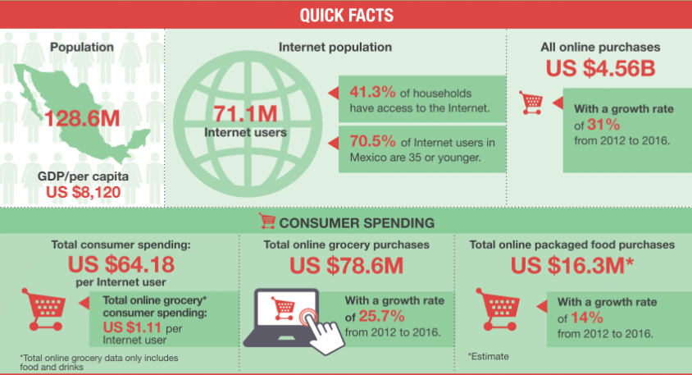
E-Commerce in México
Mexico's number of internet users projected to grow to about 91.6 million by 2021.
Mexico's digital population stood at over 70 million active internet users. (2017).
Notes:
http://www.agr.gc.ca/eng/industry-markets-and-trade/international-agri-food-market-intelligence/reports/an-overview-of-e-commerce-trends-in-mexico/?id=1504098785017
tipos de datos introductorios del tema
Internet usage in Mexico is on a steady rise with the number of internet users projected to grow to about 91.6 million by 2021. As of January 2017, Mexico's digital population stood at over 70 millionactive internet users.

Slide 4


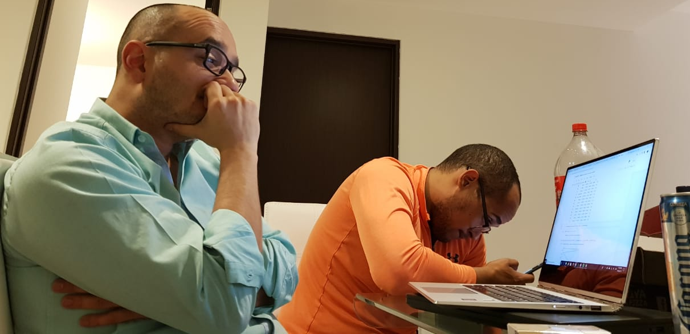
Questions
Project ideation
Inspiration
México E-commerce Study 2018 (internet.mx)
E-commerce growth
Main Questions
Where will be the next e-commerce boom in México?
What are the key states?
Where is the growth located? Growth rate per state.
Which states concentrate the biggest opportunity?

Slide 5
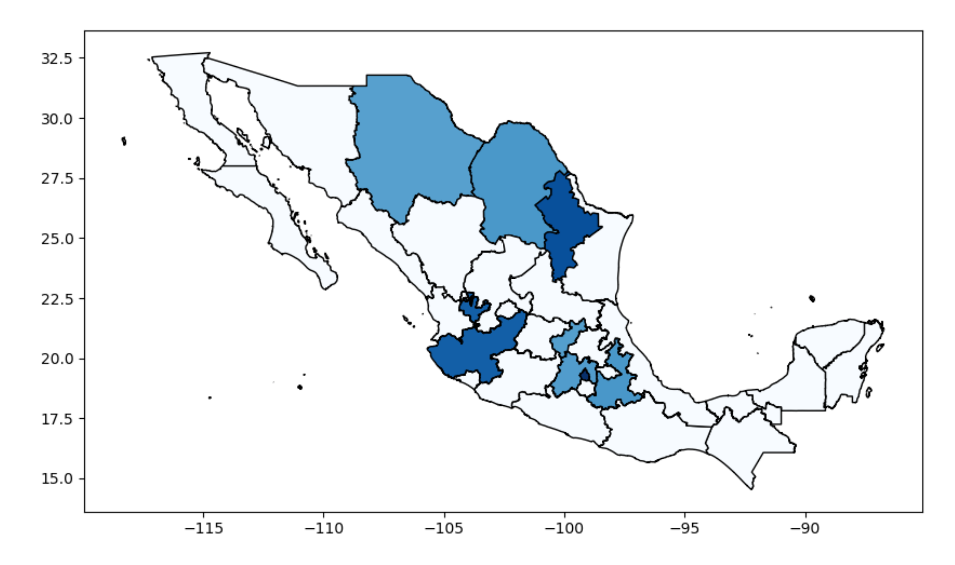
Hypothesis
In México everything (including e-commerce) is about CDMX, Guadalajara and Monterrey, but there should be another state that will have the next e-commerce boom.
Notes:
http://www.agr.gc.ca/eng/industry-markets-and-trade/international-agri-food-market-intelligence/reports/an-overview-of-e-commerce-trends-in-mexico/?id=1504098785017
tipos de datos introductorios del tema

Slide 6
Hypothesis
In México everything (including e-commerce) is about CDMX, Guadalajara and Monterrey, but there should be another state that will have the next e-commerce boom.
Notes:
http://www.agr.gc.ca/eng/industry-markets-and-trade/international-agri-food-market-intelligence/reports/an-overview-of-e-commerce-trends-in-mexico/?id=1504098785017
tipos de datos introductorios del tema

Slide 7





Datasets
Sources and datasets
Growth rate per city (INEGI))
Population density (INEGI)
Schooling of population: enrolled in university (INEGI)
Human development index (Global Data lab)
Digitization: penetration of digital markets (IFT)
Transactional and purchasing growth for mobile devices (CNBV)
Demographic projections (CONAPO)

Slide 8
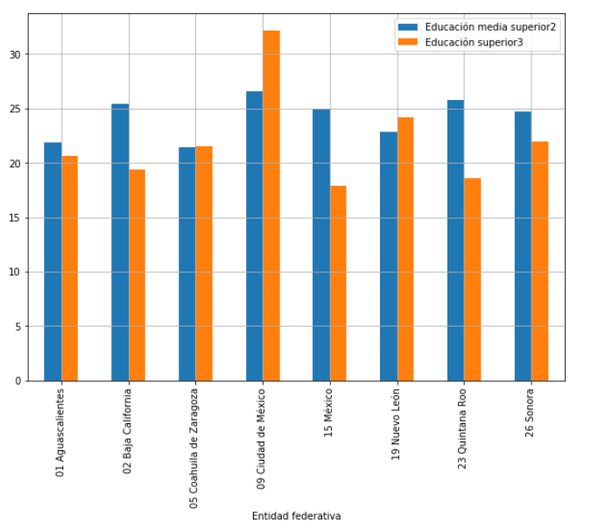
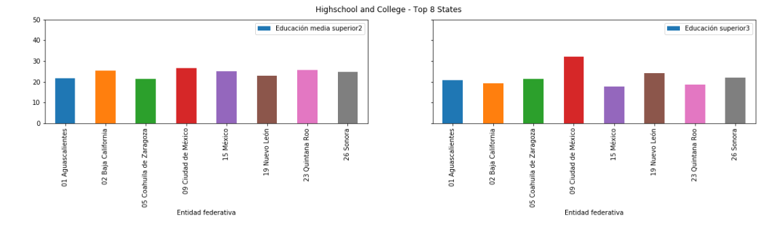
Schooling of population (INEGI)
Ciudad de MX
Nuevo Léon
Sonora
Aguascalientes
Coahuila
Baja California
Quintana Roo
Mexico
Notes:
#Nivel 2:Preparatoria o bachillerato (general o tecnológico) y normal básica.
#Nivel 3:Preparatoria terminada, profesional (licenciatura, normal superior o equivalente), especialidad, maestría o doctorado.

Slide 9
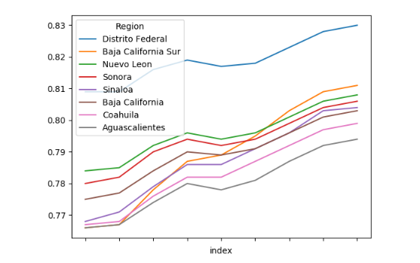
Human Development Index (Global data lab) 2010 - 2018
Distrito Federal
Baja California del Sur
Nuevo Léon
Sonora
Sinaloa
Baja California
Coahuila
Aguascaliente
Human Development Index per State

Slide 10
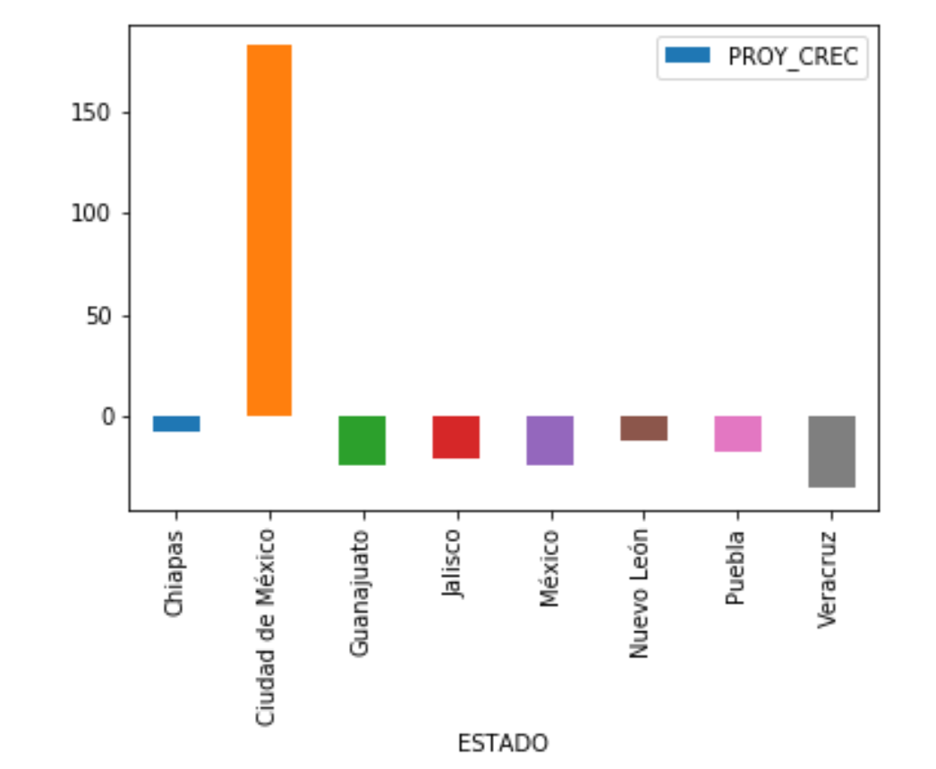
Population Growth (CONAPO) 2018 vs 2025
Top 8 States
México
Ciudad de México
Veracruz
Jalisco
Puebla
Guanajuato
Chiapas
Nuevo Léon

Slide 11
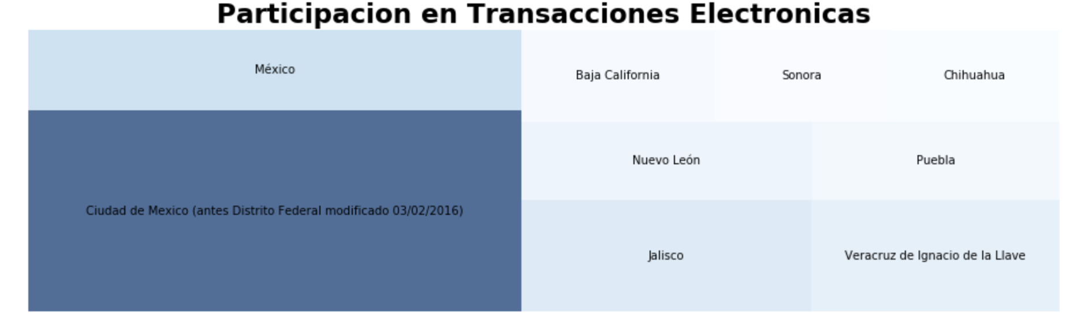
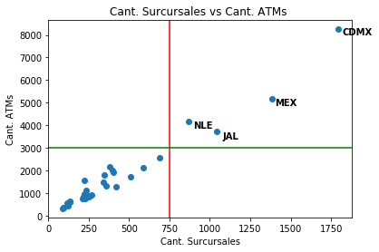
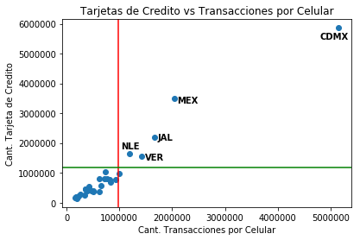
Financial Variables

Slide 12
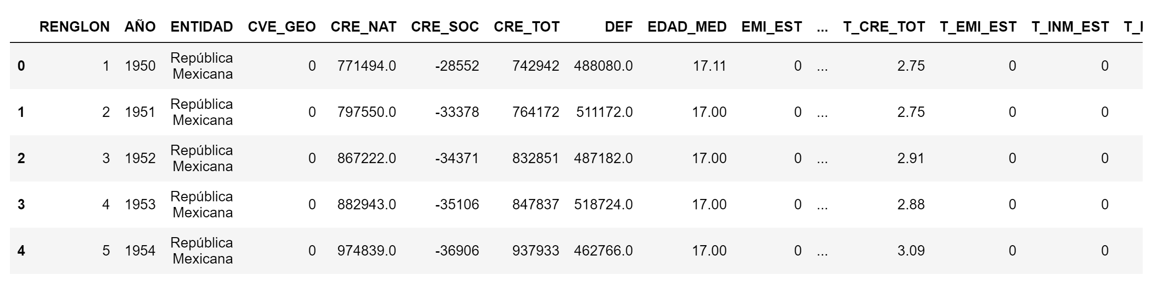
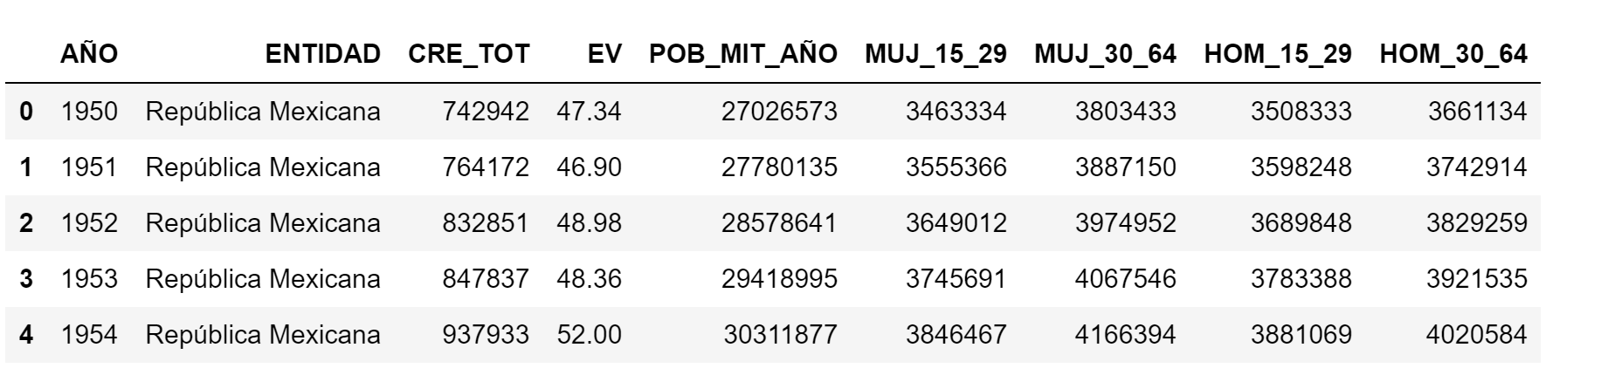
Data Preprocessing - Cleanup - exploration
1.
2.

Slide 13
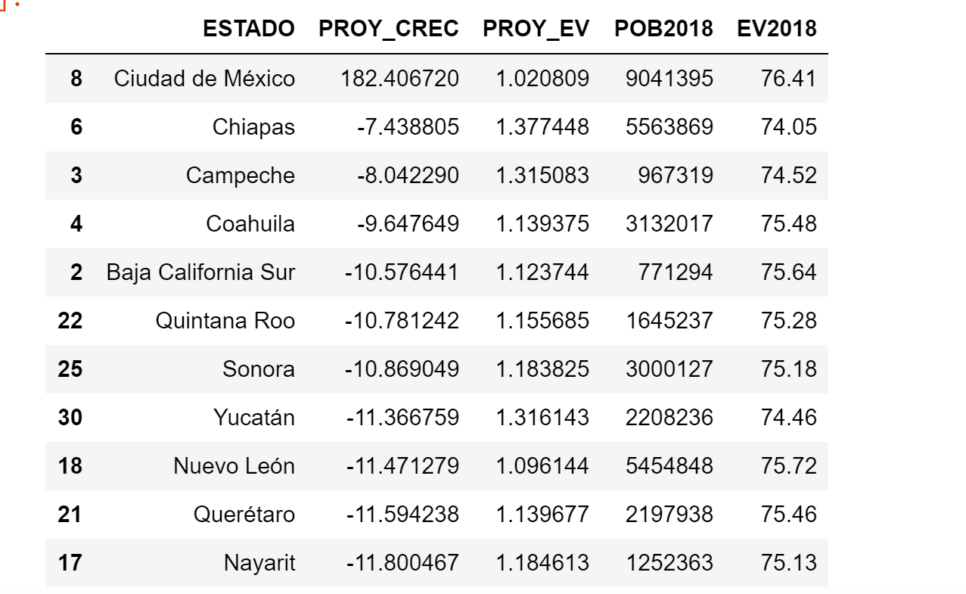
Data Preprocessing - Cleanup - exploration
3.

Slide 14

Questions?

Slide 15
Presentation Requirements | Presentation Suggestion
8-10 min. long Describe core message/hypothesis. Describe questions/motivations Summarize where and how you found the data you used Describe data exploration and cleanup process (+ Jupyter Nb) Describe analysis process (+ Jupyter Nb) Summarize conclusions numerical summary (what data did your analysis yield) visualizations (plots of the final analysis data) Implications of your findings. | Title Slide: project name & members Motivation & Summary Slide Core message/hypothesis Questions and reasoning Good answers? Summary Questions & Data Elaborate on the questions you asked & data needed Data Cleanup & Exploration Describe process Insight/problems/resolutions encountered Present and discussion Data Analysis steps Answer all question of the proposal Present interesting figures Discussion: Expectations, conclusions? Post Mortem: difficulties/solutions, what would u do differently Q&A

